Slide 1
Group 3 PROJECT KANEN ONLINE SHOPPING
Briones | Cuntapay | Flores | Kanen | Vergara | Yu

Slide 2
Contribution
Briones – Customer Model, Product Model, printReceipt, doWarehousing, validations, read and display Product Option, placeAnOrder, Warehouse model
Cuntapay – UML Diagram, Shopping main class, addBalance
Flores – registerUser, checkBalance, Customer model, UML Diagram, JUnit Test
Kanen – Regex validations, checkBalance,Warehouse model, JUnit Test
Vergara – Transaction Options,placeAnOrder, doWarehousing, Warehouse model
Yu – Product Model, Warehouse model, Shopping Transaction Class, Validator Class & validations, packaging and javadocs, doWarehousing, addBalance, placeAnOrder,

Slide 3
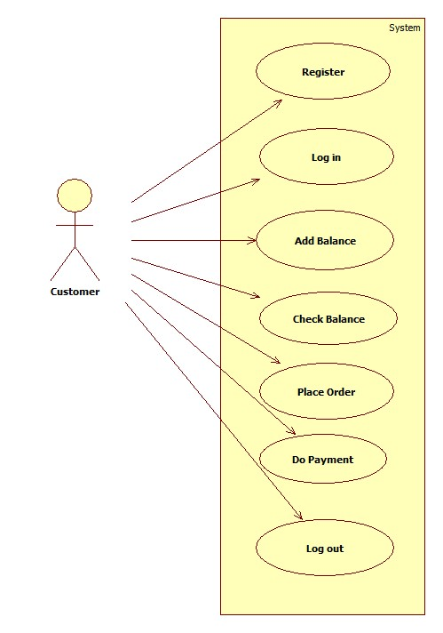
USE CASE DIAGRAM

Slide 4
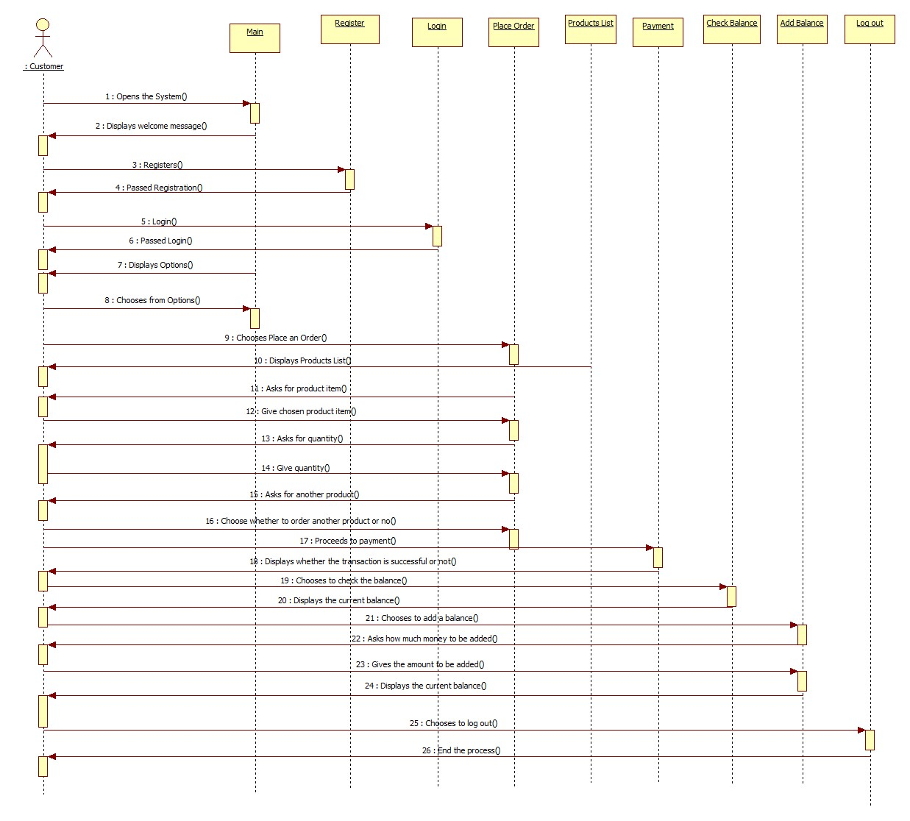
SEQUENCE DIAGRAM

Slide 5
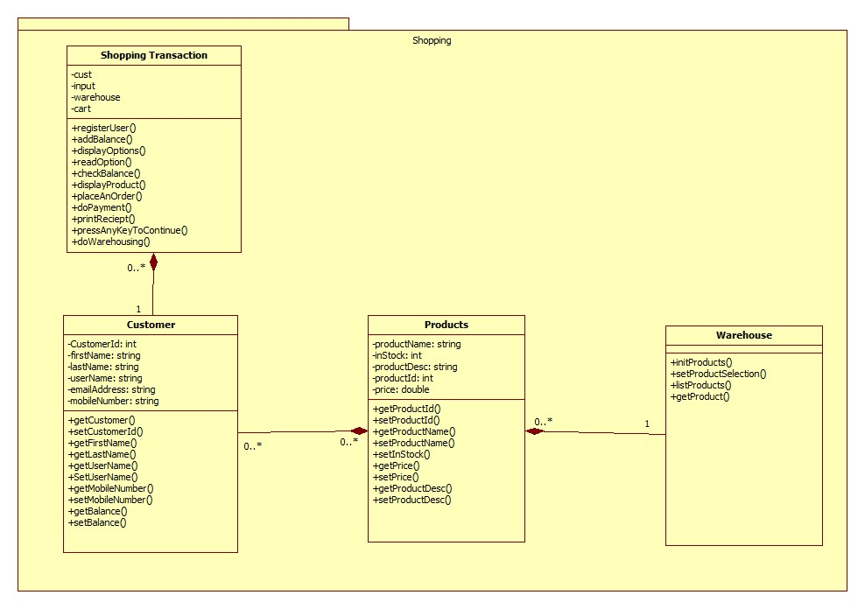
CLASS DIAGRAM

Slide 6
Project Demonstration…

Slide 7
Java Concepts Applied
Encapsulation
Getters and Setters
Pass by value
Copy Constructor
Test Case
Javadoc
Regex
Eclipse Shortcuts
Debugging & Tracking technology
Break points- step into – step over
Comments
Exception Handling
File Writer
Scanner

